Slide 1

Welcome to PowerPoint
5 tips for a simpler way to work

Slide 2
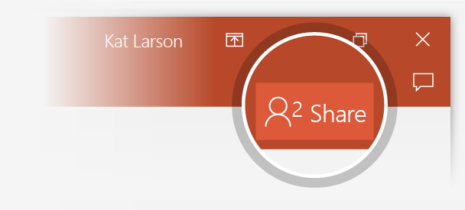
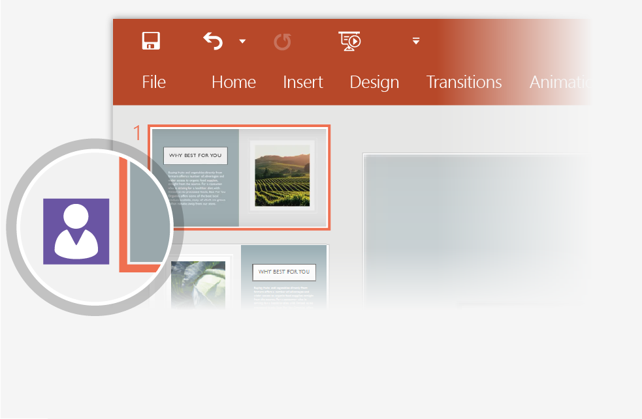
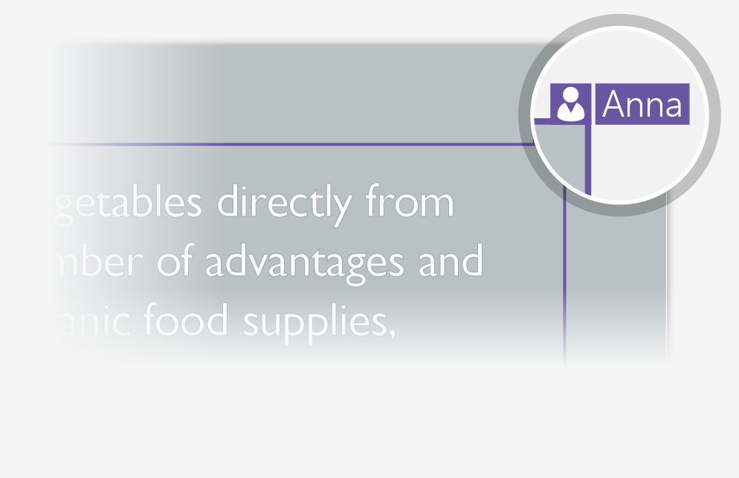
Working together in real time
When you share your presentation with others, you’ll see them working with you at the same time. How it works:
1
Click Share to invite people to work with you (You can save to the cloud at this point).
2
When other people are in the presentation, a marker shows who is on which slide…
3
…and the part of the slide they're editing.

Slide 3

Designs that fit the look of your picture
PowerPoint Designer suggests color schemes and layouts for your presentation, based on the picture you add to your slide.
Designer is a subscription-only feature. If you have an Office 365 subscription, the next slide shows you how it works in a new presentation.

Slide 4
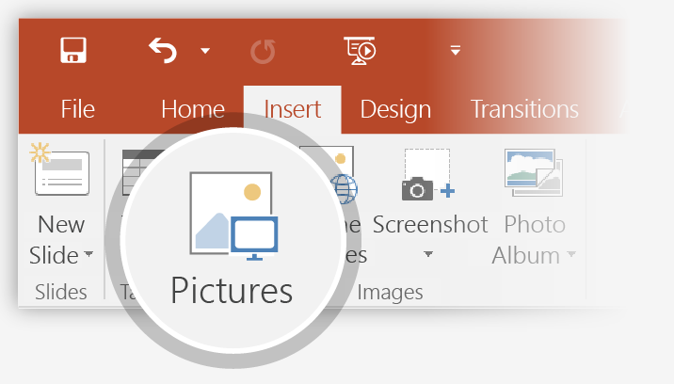
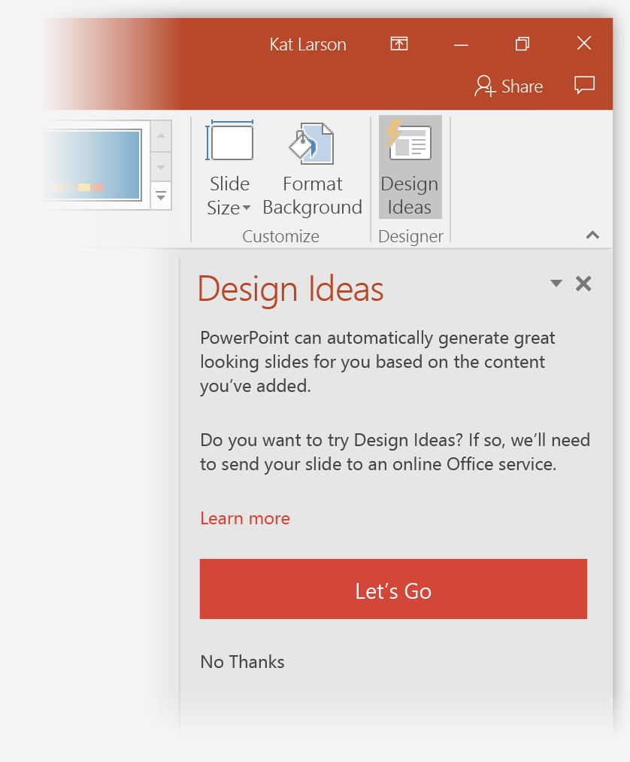
Designs that fit the look of your picture
How it works:
1
Start a new presentation by going to File > New > Blank Presentation.
2
On the very first slide, add a picture: Go to Insert > Pictures or Insert > Online Pictures and choose the picture. Hint: You need to be online when you add the picture, and the picture has to be at least 200 by 200 pixels.
3
When PowerPoint asks your permission to get design ideas, click Let's Go.
4
Choose a design you like from the Design Ideas task pane.

Slide 5
Morph
Morph is a transition effect for making smooth animations, transitions, and object movements across your slides.
Morph is a subscription-only feature. If you have an Office 365 subscription, you can try it yourself with the steps on the next slide.

Slide 6
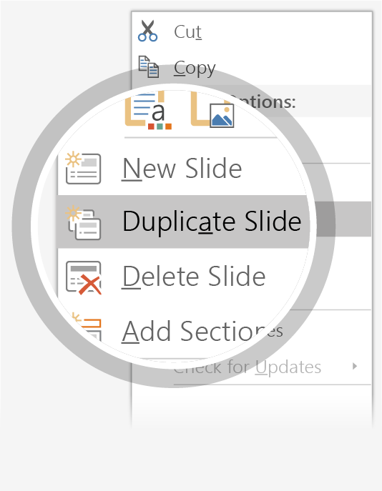
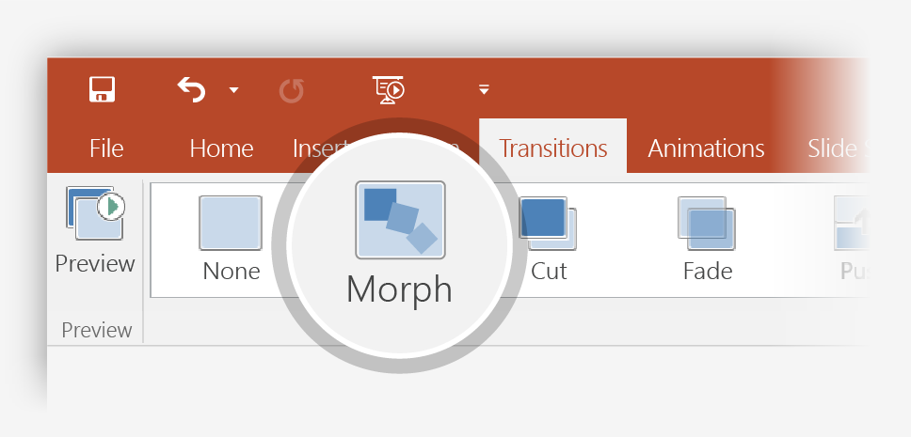

Morph
Try it:
1
Duplicate this slide: Right-click the slide thumbnail and select Duplicate Slide.
2
In the second of these two identical slides, change the shapes on the right in some way (resize, change color), then go to Transitions > Morph.
3
Return to the first of the two slides and press Slide Show button and then click Play to see your circle morph!
Hint: Effect Options gives you even more options for Morph.

Slide 7


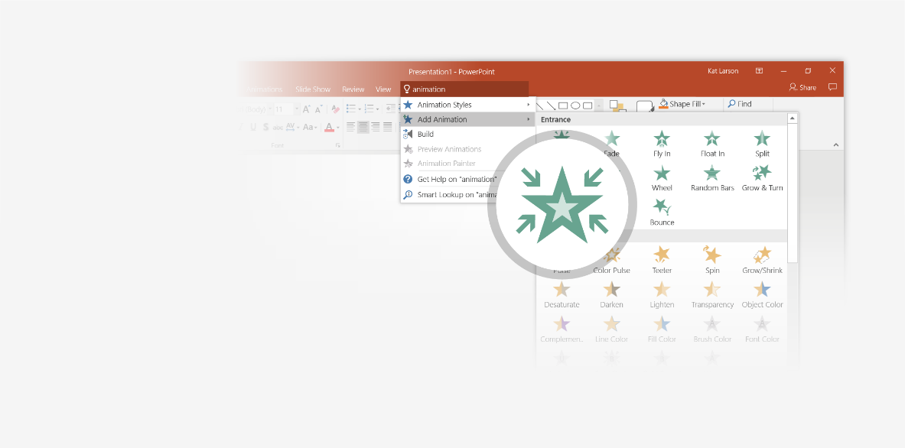
You’re an expert with Tell Me
The Tell Me box finds the right command when you need it, so you can save time and focus on your work. Try it:
SELECT ME
1
Select the picture on the right.
2
Type animation in the Tell Me box, and then choose Add Animation.
3
Choose an animation effect, like Zoom, and watch what happens.

Slide 8
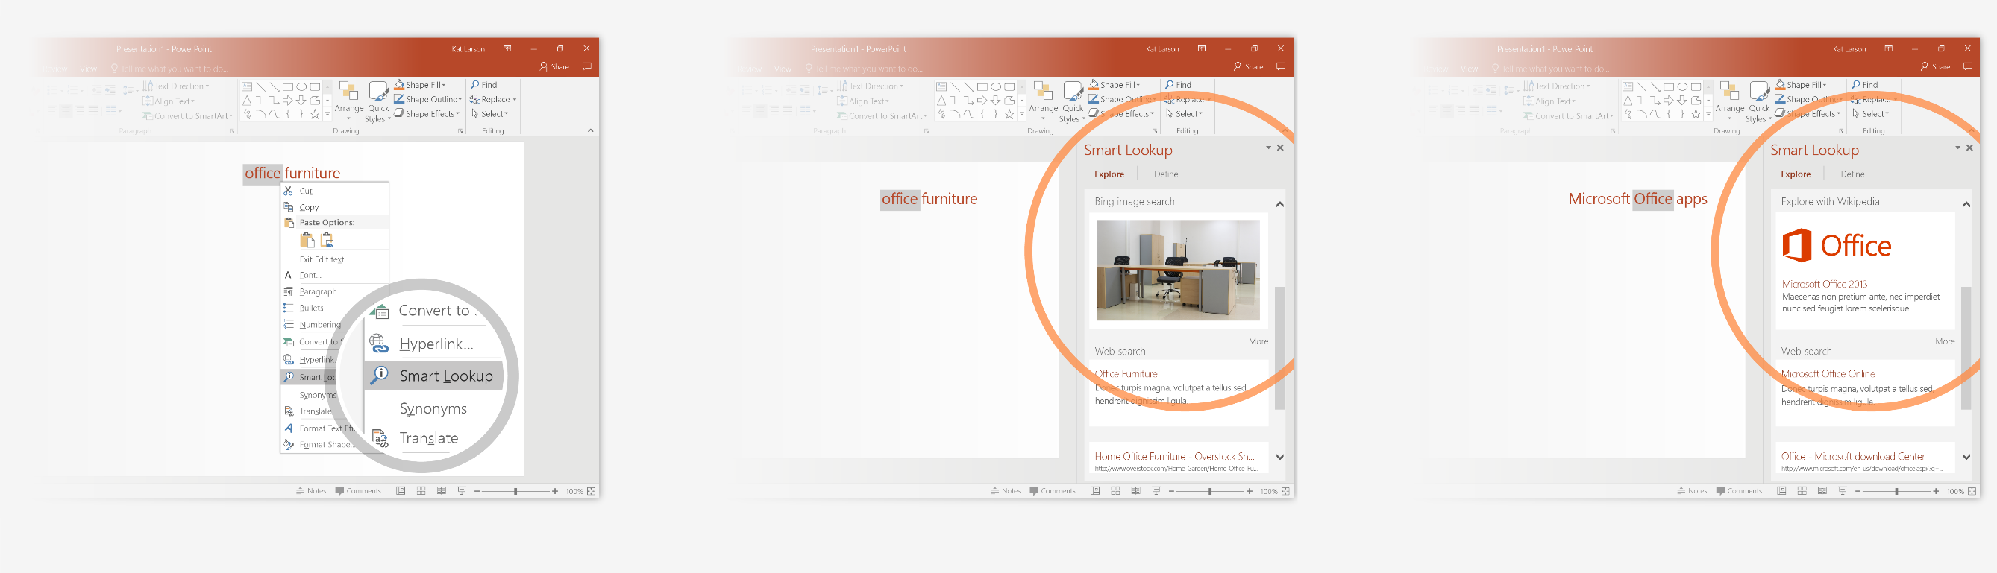
Explore without leaving your slides
Smart Lookup brings research directly in to PowerPoint. Try it:
1
Right-click in the word office in the following phrase: office furniture
2
Choose Smart Lookup, and notice that results are contextual for that phrase, not Microsoft Office apps.
3
Just for fun, try Smart Lookup again by right-clicking in the word Office in Step 2.

Slide 9

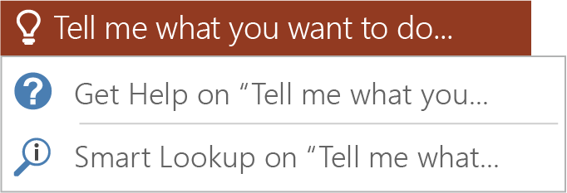

More questions about PowerPoint?
Click the Tell Me button and type what you want to know.
Visit the PowerPoint team blog.
Go to free PowerPoint training.
CLICK THE ARROW WHEN IN SLIDE SHOW MODE
Notes:
In Slide Show mode, click the arrows to visit links.

